Slide 1


V-Guard Sentinel
The inverter already knows when the power goes. Sentinel teaches it what to keep on — and when its battery will quit.
Track 4 · From Smart Products to Intelligent Products
Team Codey Tingle (TI3271) · Ayush Manoj Garg · Eshan Shukla · Tanay Chaplot
Finale · Kochi · 24 September 2026
Notes:
[0:00–0:20] Good morning. We're Team Codey Tingle. In the next ten minutes we'll show you Sentinel — first the idea, then the working prototype live, then what's proven and what isn't. Behind us is our simulated village; you'll see it in action in a few minutes.

Slide 2

10:03 pm. The battery dies — with no warning.
Three hours into a power cut, Home 6 in our village goes dark. Home 1 has the same battery and appliances — and stays lit.
85 %
of Indian households face a power cut every day (LocalCircles, 2023)
×2 wear
every +10 °C: lead-acid life halves with heat — the Indian summer is the battery's enemy
≈ 1.5 %
of V-Guard revenue goes to warranty (≈ ₹69 cr, FY24)
V-Guard Sentinel · Big Idea Tech 2026, Track 4 · Team Codey Tingle (TI3271)
2
Notes:
[0:20–0:50] Picture a family in Kochi. The evening power cut starts at seven. The inverter switches over in under ten milliseconds — it's fast. But nobody knows how much the battery has left, or how healthy it is. At three minutes past ten it simply dies: fridge, Wi-Fi, lights, all gone. Eighty-five percent of Indian homes face cuts daily. Heat halves lead-acid life every ten degrees. And for V-Guard, those surprise failures land in the warranty bill — about one and a half percent of revenue. The inverter is fast. The battery is blind. That's the gap.

Slide 3
Sentinel turns a smart inverter into an intelligent one.
Smart products take commands. Intelligent products predict, decide and act — without the cloud.
CONNECTED
app on / off
SMART
schedules · alerts · usage
INTELLIGENT
predicts failure · learns the home
acts on its own — offline
← Sentinel
1
Embedded a daughter-board inside new V-Guard inverters
2
Retrofit a 30-minute electrician fit on the installed base
3
Offline-first every core function works with zero internet
V-Guard Sentinel · Big Idea Tech 2026, Track 4 · Team Codey Tingle (TI3271)
3
Notes:
[0:50–1:10] Our idea in one sentence: Sentinel turns V-Guard's smart inverter into an intelligent one. Today's products take commands. Sentinel predicts when the battery will fail, decides which loads to keep alive, and acts on its own — even with no internet, which in India is a feature, not a compromise. It ships two ways: built into new inverters, or retrofitted by an electrician in half an hour.

Slide 4
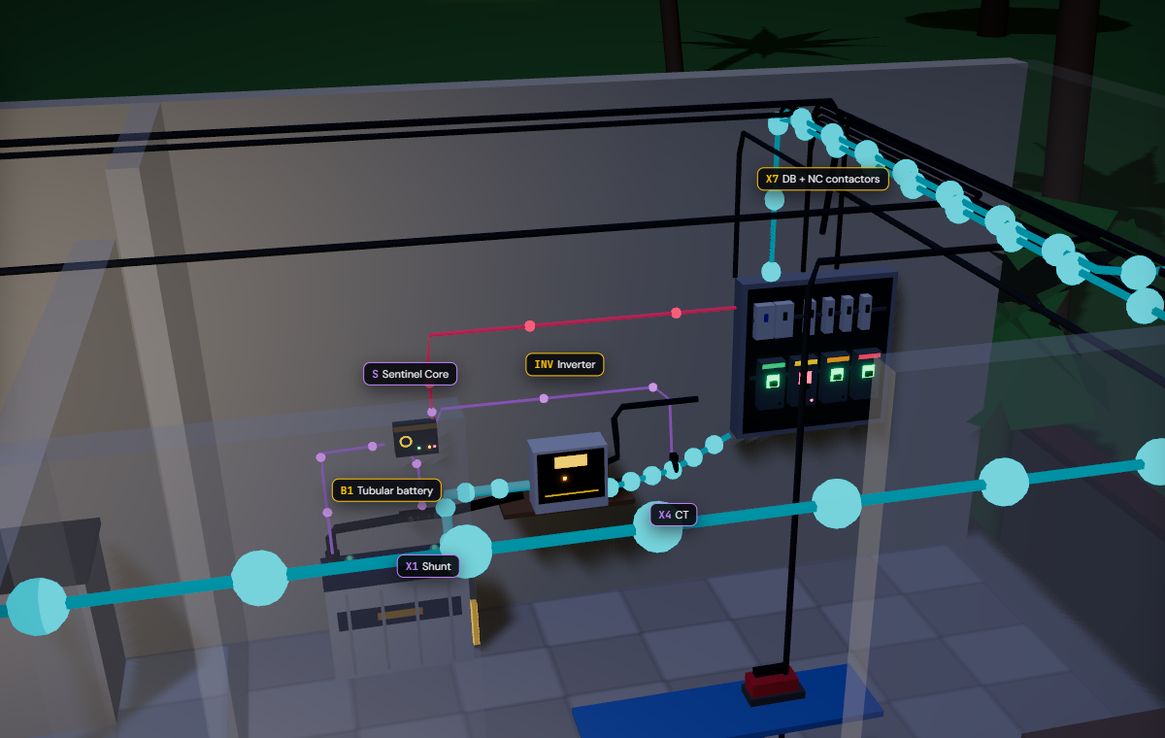
One small box reads the battery and switches the loads.
Nothing on the battery or the inverter is modified on the retrofit — only the negative cable passes through a shunt.
1
Shunt in the battery − lead
battery current → INA228
2
NTC on the battery post
temperature: the #1 ageing driver
3
CT + voltage tap on AC-OUT
real & reactive power → ATM90E32AS
4
4 NC contactors in the DB
coil off = load ON, always
5
ESP32-S3 Sentinel Core
90 × 70 × 35 mm, powered by the battery
V-Guard Sentinel · Big Idea Tech 2026, Track 4 · Team Codey Tingle (TI3271)
4
Notes:
[1:10–1:35] Physically, Sentinel is a box the size of a deck of cards beside the inverter. This is the 'power corner' of Home 1 in our simulation. Five touch points: a shunt in the battery's negative cable for current, a temperature probe on the battery post, a current transformer on the inverter output, four fail-safe contactors in the distribution board — and the ESP32 core itself. Gold dots are mains power, cyan is battery power, violet is Sentinel sensing.

Slide 5
Four jobs, one board — all on the ESP32, no cloud needed.
1
2
3
4
Battery health
Habit autopilot
Energy coach + grid shield
Signed health log
Predicts a replacement window — 'replace in 6–14 weeks'
Keeps the fridge, lights and router alive during a cut
Names the big appliances; logs every sag and swell
Tamper-proof record — warranty decided by evidence
Same core, same sensors, different models → the platform extends to pumps, stabilisers and water heaters.
V-Guard Sentinel · Big Idea Tech 2026, Track 4 · Team Codey Tingle (TI3271)
5
Notes:
[1:35–1:50] Four jobs, one board. One: battery health — a warning window, not a guess. Two: the autopilot that keeps essentials alive. Three: the energy coach and grid shield — which appliances use what, and what the grid did to your home. Four: a signed health log, so warranty is decided by evidence, not argument. Let me take them one at a time, quickly.

Slide 6
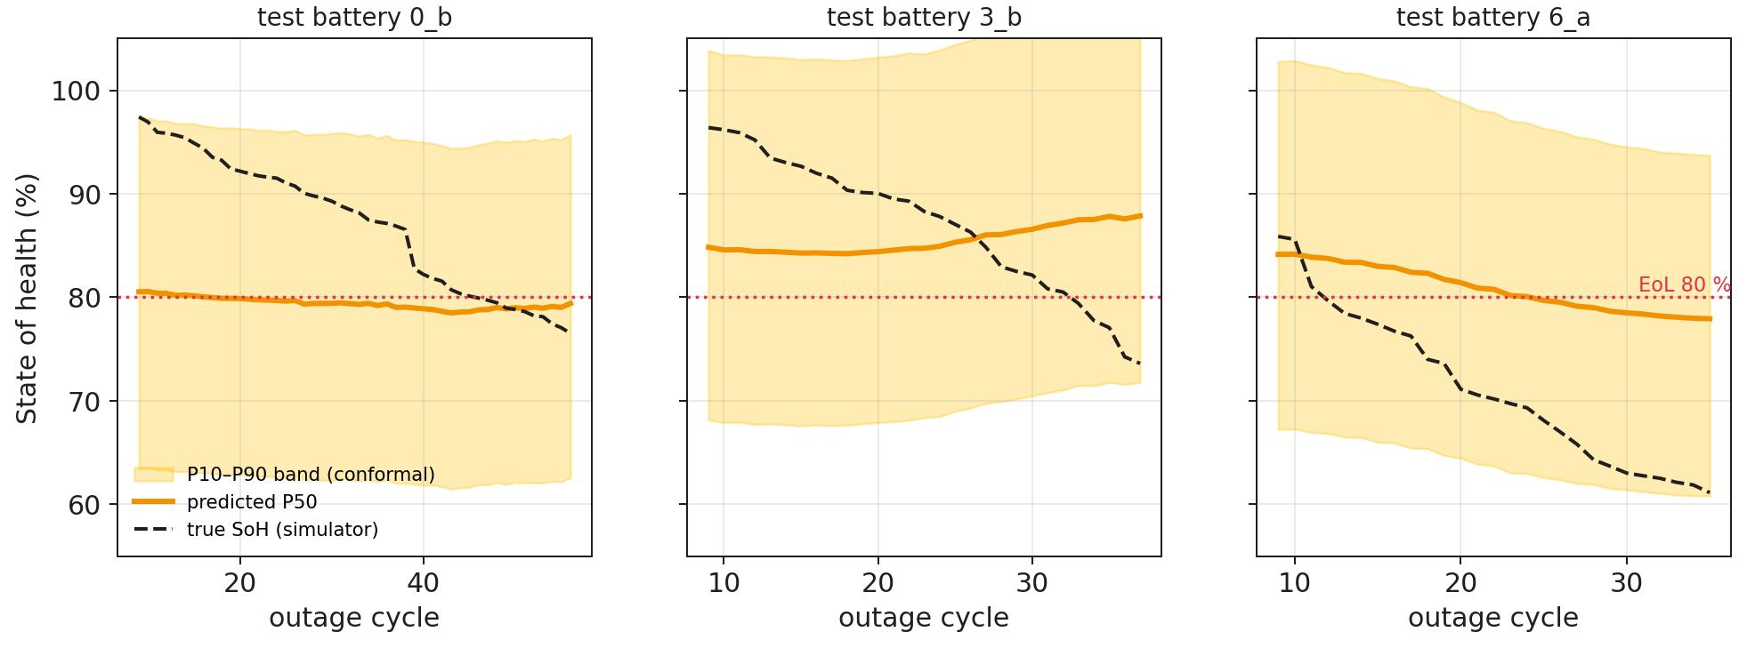
It gives a window, not a date: "replace in 6–14 weeks".
Physics first, learning second — every step runs on the ESP32.
1 Hz sensing
I · V · T
Kalman filter
SoC · R_int
14 + 6 features
per outage cycle
int8 CNN × 3
28 k params · 16 KB
Grade
window, never a date
8.2 pt
SoH error on 3 never-seen test batteries (synthetic data — honest, not flattering)
+0.01 pt
accuracy lost going float → int8 — it fits on the chip for free
Band is calibrated but wide today; the Kochi aging campaign narrows it.
V-Guard Sentinel · Big Idea Tech 2026, Track 4 · Team Codey Tingle (TI3271)
6
Notes:
[1:50–2:25] How does a small microcontroller predict battery life? Physics first. A Kalman filter turns current, voltage and temperature into charge and internal resistance. Each outage becomes 20 features the lead-acid literature says drive wear — resistance growth, heat stress, depth of discharge. A tiny int8 network — 28 thousand parameters, 16 KB of RAM — outputs a band, and we show a window: replace in 6 to 14 weeks, plan for 6. Honest numbers: on three batteries the model has never seen, the error is 8.2 points — on synthetic data. The band is calibrated but wide; real tubular aging data from the Kochi lab is what narrows it. And quantising to int8 cost us one hundredth of a point.

Slide 7
Same outage, same battery: only Home 1 keeps its fridge on.
Battery charge through the 7–11 pm cut, straight from our simulation engine, using our specified shed thresholds.
57 min
Home 6 sat in the dark until mains returned at 11 pm
8:24 pm · fans & TV deferred
(T2 at 55 %)
0 min
Home 1's fridge, router and hall light were never off
10:37 pm · heavy sockets shed
(T3 at 40 %)
Coil off = load on.
NC contactors, a hardware supervisory timer and a medical jumper: any crash or reset brings every load back.
10:03 pm · Home 6 cut-off:
fridge, router, lights OFF
V-Guard Sentinel · Big Idea Tech 2026, Track 4 · Team Codey Tingle (TI3271)
7
Notes:
[2:25–3:00] This is the heart of it, and it isn't a drawing — it's the output of our simulation engine. Home 1 and Home 6 have the identical 150 Ah battery and identical appliances. Only Home 1 has Sentinel. At 8:24 pm Home 1 drops to 55 percent and defers the fans and TV; its curve flattens. Home 6 keeps burning everything, and at 10:03 pm hits the cut-off — fridge, router, lights, all off for 57 minutes. Home 1 sheds the heavy sockets at 40 percent and keeps its essentials on till mains returns. The rule is a readable ladder — 55 and 40 percent with hysteresis — not a black box. And every contactor is normally-closed: if Sentinel crashes, every load comes back on.

Slide 8
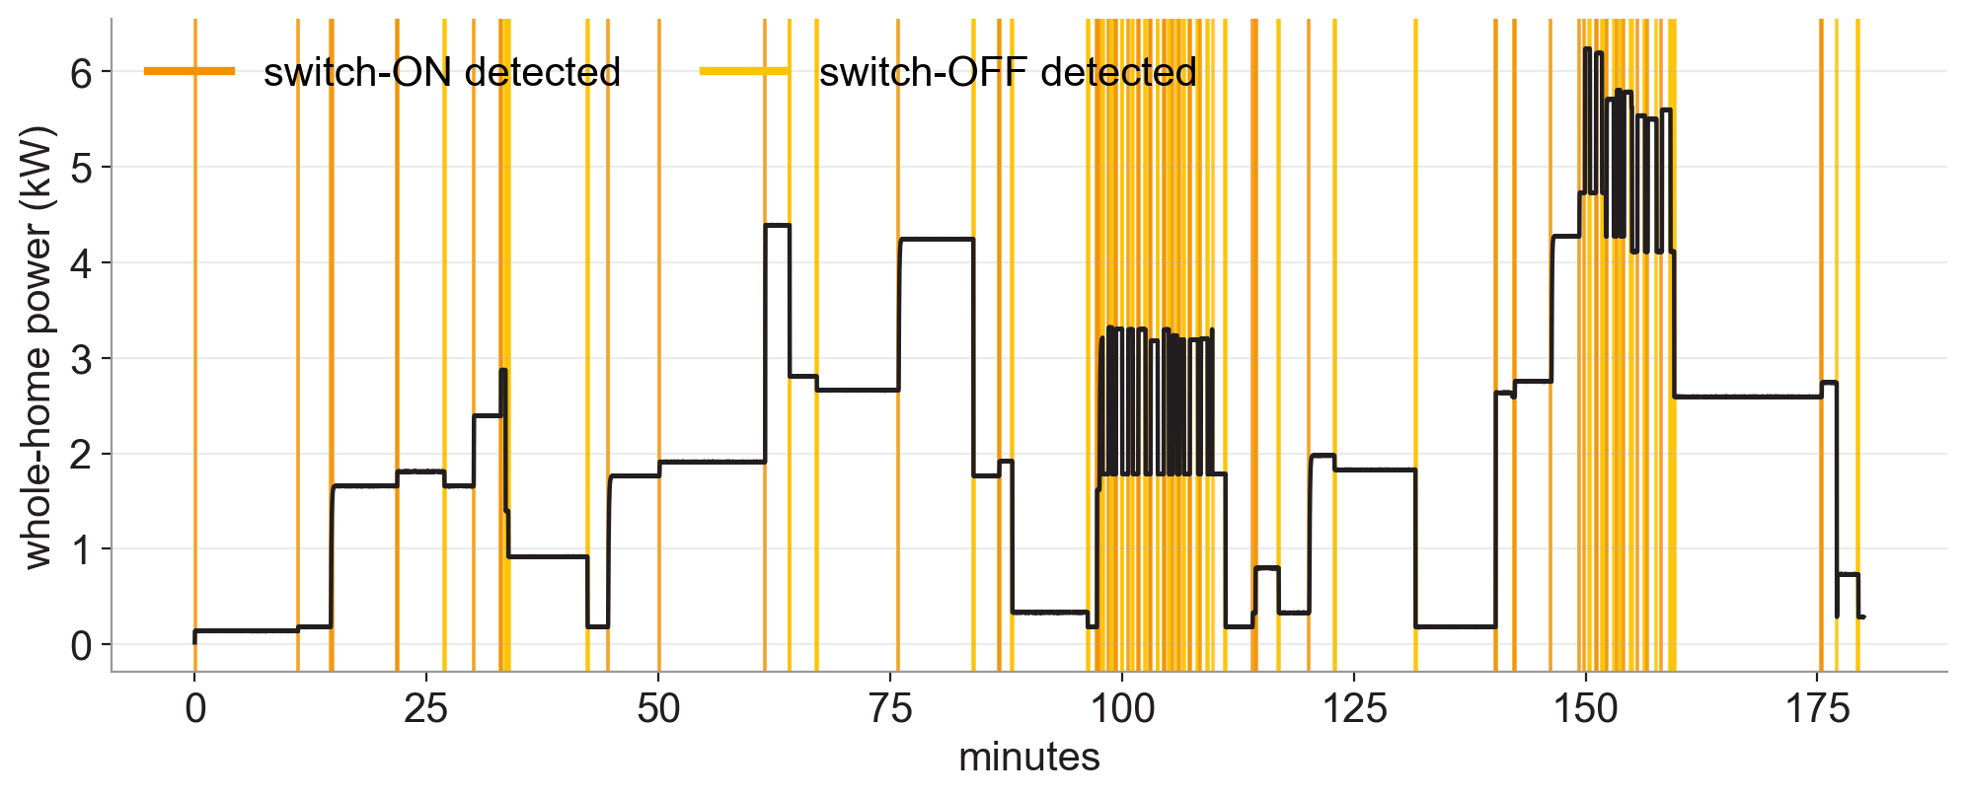
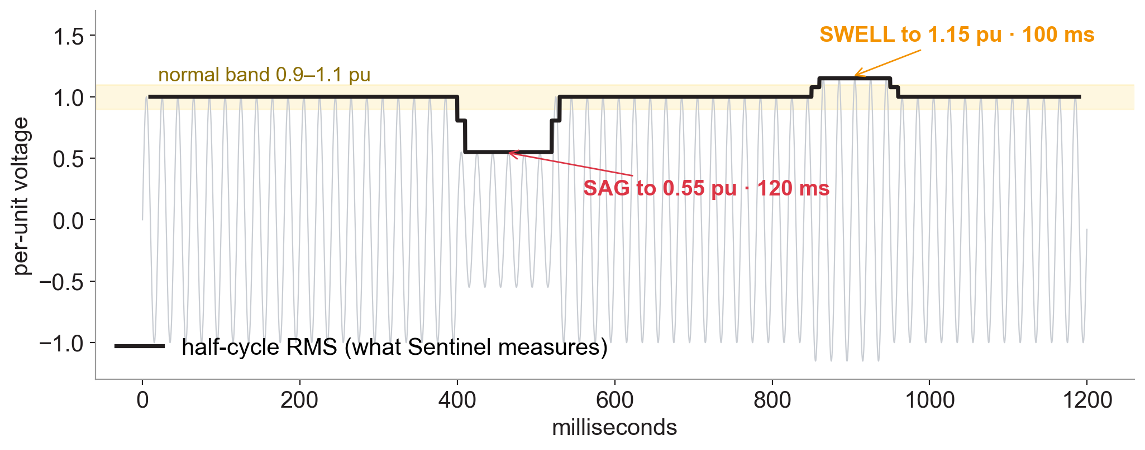
One sensor saves energy and catches a misbehaving grid.
Both run on the metering front-end (ATM90E32AS) and the isolated voltage tap (AMC1311) — outputs of the team's own detector code.
Energy Coach 123 switch-ON/OFF events found in 3 h of whole-home power; each becomes a 13-number signature. Fridge F1 0.97, iron 1.00.
Grid Shield a 120 ms sag to 0.55 pu measured as 0.54; a 100 ms swell to 1.15 pu as 1.16. 13 / 13 dips caught. Logged, dated, signed.
V-Guard Sentinel · Big Idea Tech 2026, Track 4 · Team Codey Tingle (TI3271)
8
Notes:
[3:00–3:25] Engine three. We added a real metering chip on the inverter output — the kind inside a smart meter. On the left, three hours of a home's power: every orange line is an appliance switching on, gold is off — 123 events, each turned into a signature so the app can ask 'what just turned on?'. On the right, the grid shield: the chip computes RMS every half cycle, catches a 120-millisecond sag and a swell, and writes them into the signed log — evidence for the owner when a fluctuation damages an appliance. We're honest about scope: big appliances, not two identical fans.

Slide 9
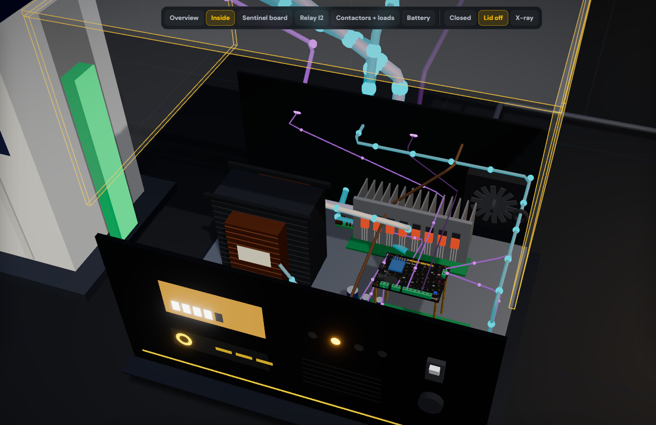
Inside the inverter, Sentinel taps what's already there.
Our 3D proof of concept of the Embedded SKU: lid off, every part clickable, live power flow.
1
Inverter's own shunt (I8)
→ INA228 · battery current
2
Mode / mains line
→ PC817 opto · outage vote s2
3
SG3525 charge feedback
→ MCP4725 DAC · temperature-compensated charging
4
AC-OUT rail
→ AMC1311 + ATM90E32AS · V, P, Q
5
4 coil outputs
→ NC contactor panel · T1 / T2 / T3 / medical
V-Guard Sentinel · Big Idea Tech 2026, Track 4 · Team Codey Tingle (TI3271)
9
Notes:
[3:25–3:45] For new V-Guard inverters Sentinel isn't a box — it's a daughter-board inside. This is our 3D proof of concept with the lid off: transformer, MOSFET bridge, changeover relay, control board, and our board on standoffs. It taps five things the inverter already has: its current shunt, its mode line, the charger's feedback node — which is how Sentinel does temperature-compensated charging, only on the embedded version — the output rail, and four coil outputs to the contactors.

Slide 10
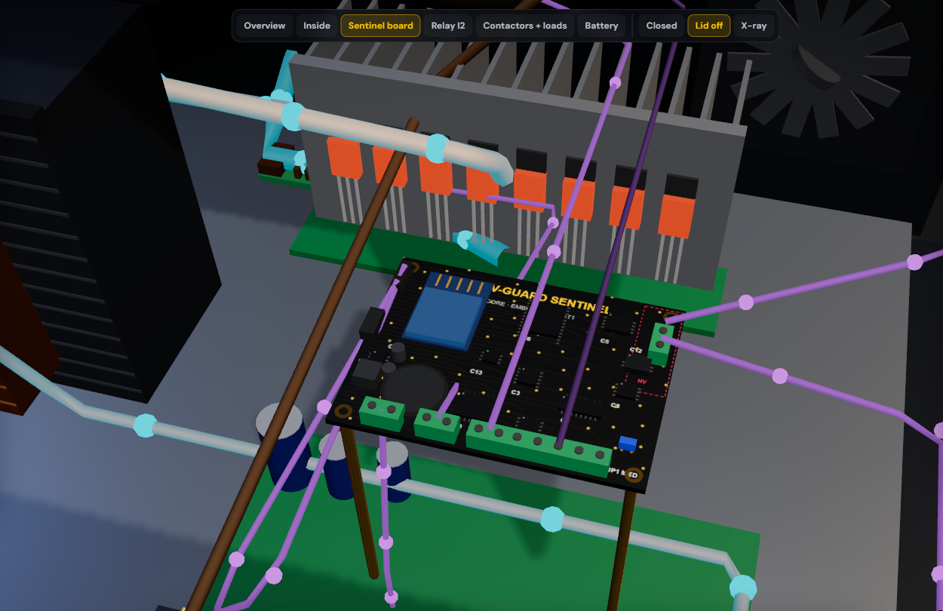
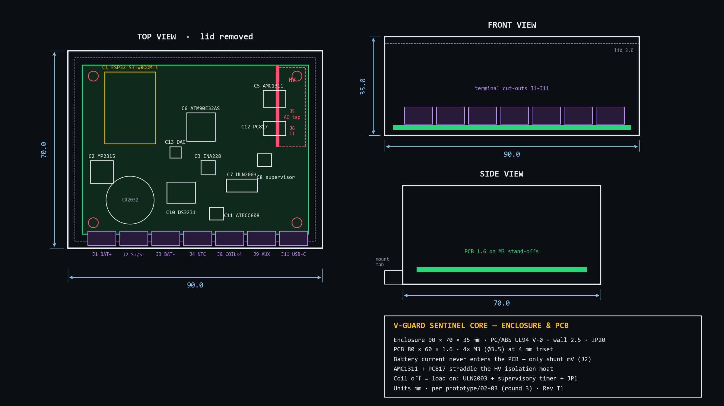
Designed to be built: 90 × 70 × 35 mm, HV zone fenced off.
Mechanical drawing from our final spec, and the same board as a 3D render in the simulation.
Battery current never enters the PCB
only the shunt's millivolts do.
Isolation moat
AMC1311 and PC817 straddle the HV zone.
UL94 V-0 PC/ABS, 4× M3
DIN or screw mount beside the inverter.
V-Guard Sentinel · Big Idea Tech 2026, Track 4 · Team Codey Tingle (TI3271)
10
Notes:
[3:45–4:00] It's designed to be built. Enclosure 90 by 70 by 35, board 80 by 60, flame-retardant plastic. Two things we'd point an engineer to: the battery's 30-plus amps never touch our board — only the shunt's millivolts do — and the mains-side sensing sits behind an isolation moat that the isolated amplifier and optocoupler straddle. On the right, the same board as a 3D render with every chip where the drawing puts it.

Slide 11
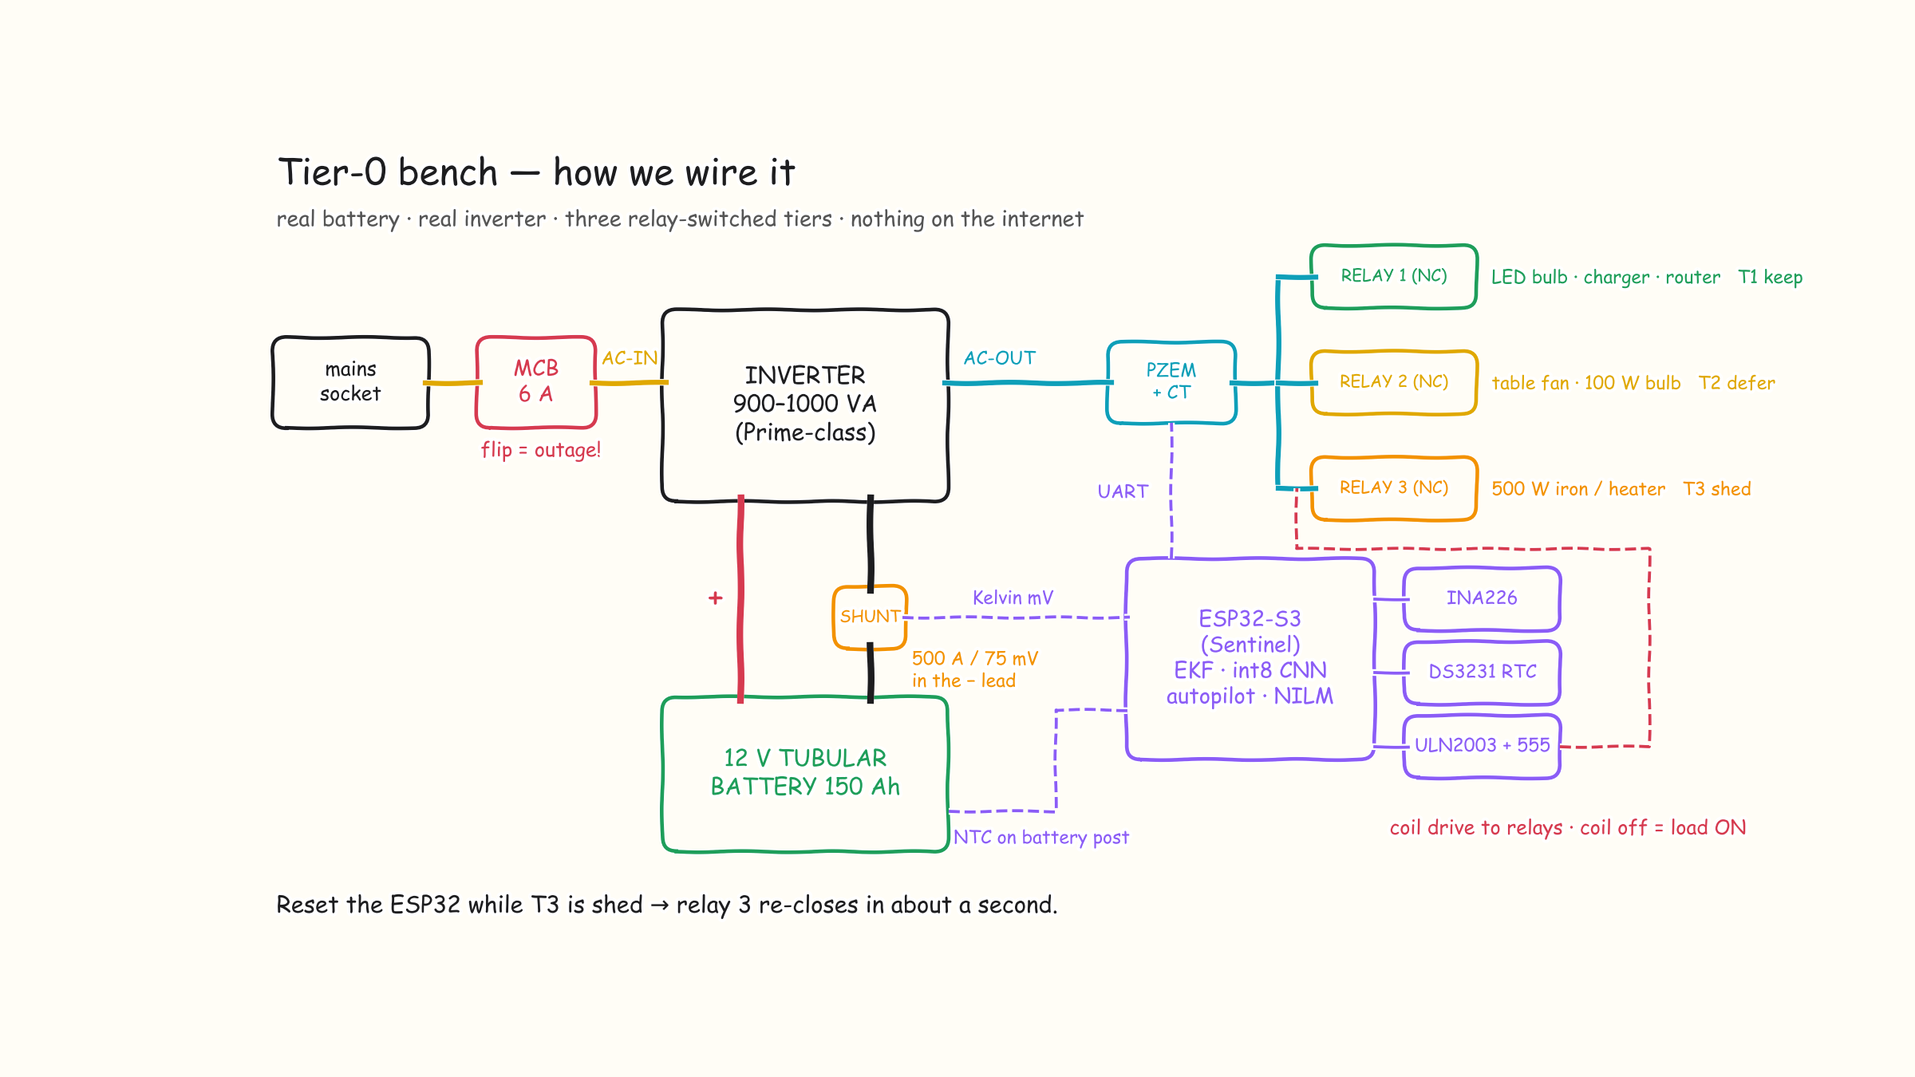
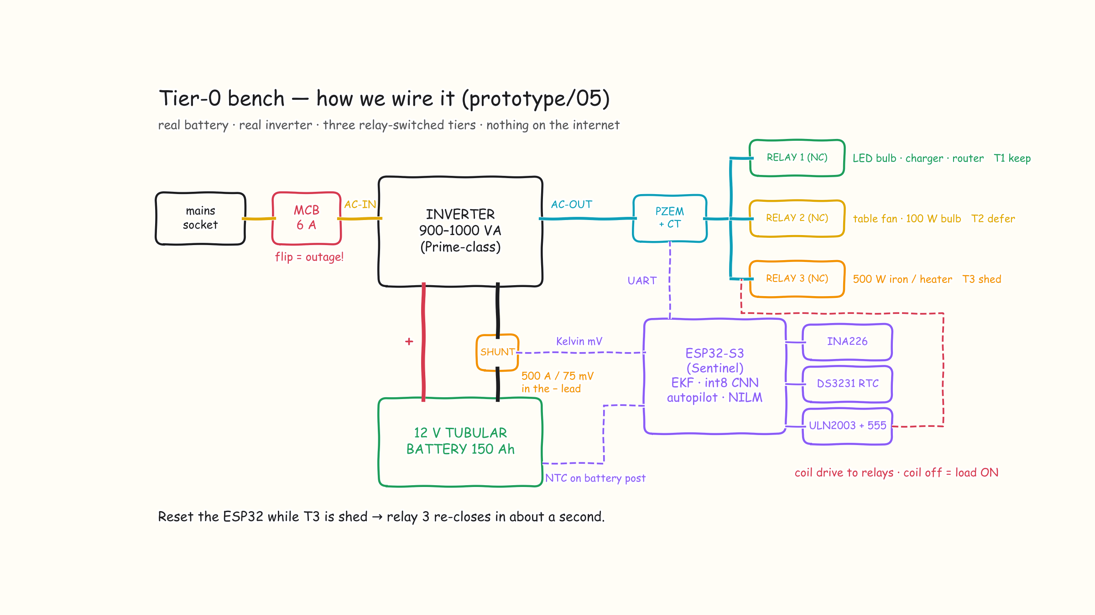
And this is exactly how the bench is wired.
Real battery, real inverter, off-the-shelf parts. Every component is available from Indian distributors today.
V-Guard Sentinel · Big Idea Tech 2026, Track 4 · Team Codey Tingle (TI3271)
11
Notes:
[4:00–4:10] And the simplest version — our bench sketch. Mains through a 6-amp MCB into a Prime-class inverter, a 150 Ah tubular battery with the shunt in its negative lead, an ESP32, and three normally-closed relays for the three tiers. Flipping that MCB is our outage. Let's do exactly that, live.

Slide 12

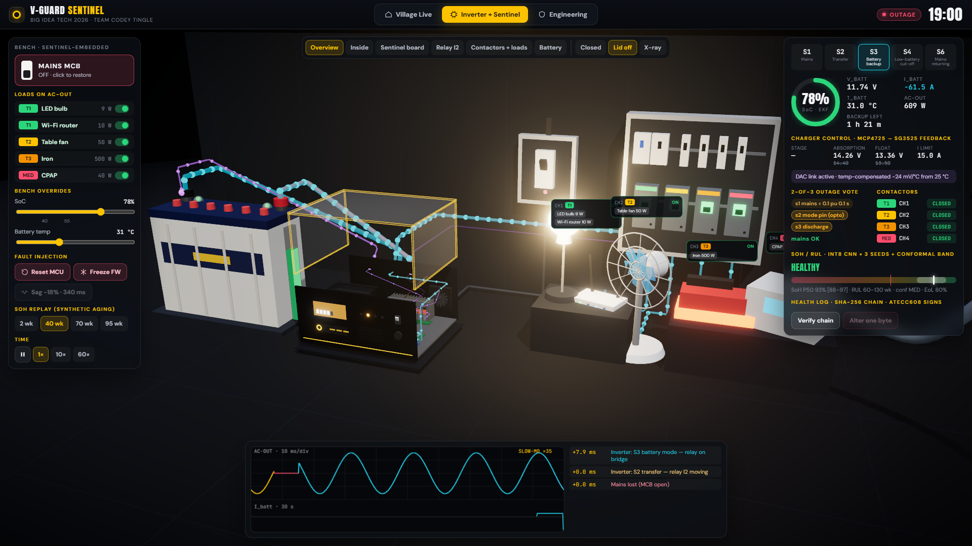
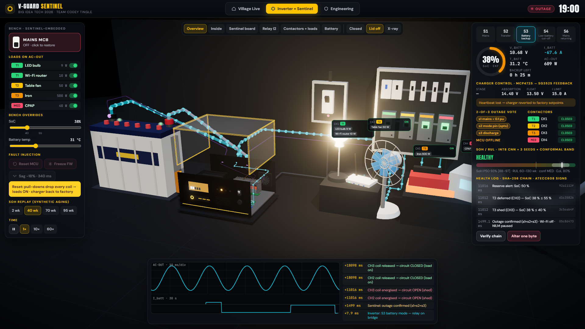
Let's watch it happen — live.
Sentinel Live runs offline in one HTML file. Three moments to watch for:
1 · The village
2 · Flip the MCB
3 · Crash it
Feeder cuts at 7 pm. Watch Home 6 go dark at 10:03 while its twin stays lit.
Relay swings in slow motion: 8 ms gap on the scope, outage confirmed in 1.5 s.
Drop SoC below 40 % → the iron sheds. Reset the chip → every load comes back.
V-Guard Sentinel · Big Idea Tech 2026, Track 4 · Team Codey Tingle (TI3271)
12
Notes:
[4:10–8:10] LIVE DEMO (about 4 minutes). Switch to Sentinel-Live.html, full screen.
1) Village tab: press ⏭ 18:58 at 180×. Feeder drops at 19:00 — flows turn cyan, street lights go out. Click Home 1 → Power corner: point at shunt, NTC, CT, Sentinel, contactors. ⏭ 20:20: T2 deferred (bedroom dark). ⏭ 21:55: at 22:03 Home 6 goes DARK; Home 1 still lit. Press Reset MCU on Home 1: all loads back, re-shed after reboot.
2) Inverter + Sentinel tab: switch the iron on. Click MAINS MCB → slow motion: relay swings, scope shows the 8 ms gap gold→cyan, timeline +0.0 / +8.0 ms, Sentinel confirms at ~1.5 s. Hover the board: C1 ESP32, C6 metering, C13 DAC.
3) Drag SoC to 38 % → CH3 opens, iron goes cold; fan deferred. Reset MCU → everything back, charger reverts to factory. Restore MCB → S6 then bulk charging. Temp slider to 45 °C → setpoints drop, current derates. Verify chain → alter one byte → broken.
Back to slides.

Slide 13
What's proven, what's synthetic, and what still needs hardware.
We'd rather you trust three honest columns than one shiny number.
245
6
3 %
13 / 13
automated tests, all passing
C modules bit-identical to Python
Kalman SoC error vs 7.2 %/week naive
grid dips detected
PROVEN IN CODE
SYNTHETIC ONLY
NEEDS HARDWARE / DATA
▪ int8 model exported + golden self-test in C
▪ autopilot: 50 / 50 C scenarios, zero chatter
▪ signed log: tamper, delete, replay caught
▪ SoH 8.2 pt on simulated tubular batteries
▪ RUL band calibrated (0.99) but wide
▪ NILM / PQ on synthetic streams
▪ ESP32 flash + latency on silicon
▪ real bench: battery, CT, relays
▪ aging campaign → real SoH accuracy
V-Guard Sentinel · Big Idea Tech 2026, Track 4 · Team Codey Tingle (TI3271)
13
Notes:
[8:10–8:40] Credibility is the whole game with R&D judges, so here it is plainly. Proven in code: 245 tests, six C modules that match Python bit for bit, an int8 model that self-tests in C, and a signed log that catches tampering — you just saw it break. Synthetic only: the battery-health accuracy and the appliance numbers, because no real tubular aging data exists yet. Needs hardware: flashing to the ESP32, the physical bench, and the aging campaign. We also cut federated learning from this prototype on purpose — it's designed, not built.

Slide 14
Sentinel pays off for the family and for V-Guard.
One home with a ₹15,000 battery, and V-Guard across 1 lakh such homes.
THE FAMILY
V-GUARD
battery revenue from 1 lakh homes, ₹ cr a year
2.5×
longer backup for the fridge, Wi-Fi and lights
6–14 wk
warning before the battery dies
₹6,250
Break-even at 48 % share of replacements
1 % less warranty cost ≈ ₹0.7 cr a year
less spent on batteries per decade*
* Embedded, if charge control adds 20 % life (to be measured). Model: 4-year battery life, 40 % of replacements to V-Guard today (assumed). Warranty: V-Guard Annual Report FY24.
V-Guard Sentinel · Big Idea Tech 2026, Track 4 · Team Codey Tingle (TI3271)
14
Notes:
[8:40–9:00] For the family: the essentials last about two and a half times longer, because they draw about 40 percent of the full load. The battery gives six to fourteen weeks' warning instead of dying without notice. And if the embedded version's charging adds the 20 percent life we're targeting, that's about 6,250 rupees less on batteries per decade. For V-Guard, per 1 lakh homes: longer life means fewer purchases, 15 crore drops to 12.5. But the warning tells V-Guard who will buy a battery and when. Win 48 percent of those replacements and it breaks even; at 55 percent it's 17.2 crore a year. And every 1 percent of warranty cost settled by signed evidence is about 70 lakh a year.

Slide 15
A growing market, and fewer batteries in scrap yards.
India's home backup still runs on lead-acid.
US$ 487 M
~53 %
60–80 %
~42,000
home-UPS market
by 2030
of inverter batteries
are lead-acid
of used lead-acid is
recycled informally
fewer batteries per lakh
homes, per decade*
1
2
3
Planned replacements
Take-back at the warning
Upgrade, don't replace
The warning window becomes a planned sale.
Old batteries go to authorised recyclers.
Retrofit makes today's inverters intelligent.
* 1 lakh homes, 4-year life today, +20 % with Sentinel-Embedded. Sources: MarketsandMarkets (home UPS), Mordor Intelligence (chemistry share), industry recycling estimates.
V-Guard Sentinel · Big Idea Tech 2026, Track 4 · Team Codey Tingle (TI3271)
15
Notes:
[9:00–9:20] Why it's worth building. The home-UPS market heads to about 487 million dollars by 2030, and over half of inverter batteries are still lead-acid, exactly what Sentinel is for. Nobody in India sells predictive battery intelligence yet. And 60 to 80 percent of used lead-acid batteries end up with informal recyclers. Sentinel's warning window turns a surprise failure into a planned V-Guard sale, and the same moment is a take-back: the old battery goes to an authorised recycler. Longer life means about 42 thousand fewer batteries per lakh homes per decade. And the retrofit upgrades inverters already on the wall instead of replacing them.

Slide 16
Three validation gates — and what we need to pass the first.
1
2
3
GATE 1 · DATASET
GATE 2 · FIELD PILOT
GATE 3 · PRODUCT
6–8 months · Kochi reliability lab
6 months · 100 retrofit homes
Smart Pro family
24–36 tubular batteries at 3 temperatures × 3 depths → real SoH labels and a measured life-extension number
SoC within 3 %, ≥ 75 % RUL-window hit rate, zero unsafe sheds, fridge/AC F1 ≥ 0.8
Embedded SKU into the inverter that already has Wi-Fi, BLE and the Smart 2.0 app
What V-Guard gains
battery replacements at the right time · warranty by evidence · a premium 'intelligent' tier · a fleet-data moat
What we ask for
one opened Prime-series inverter + charger schematic · ESP32 bench parts · batteries and cyclers for Gate 1
V-Guard Sentinel · Big Idea Tech 2026, Track 4 · Team Codey Tingle (TI3271)
16
Notes:
[9:25–9:45] Our roadmap is written as gates, not dates. Gate one: a proper aging campaign in V-Guard's Kochi reliability lab — that's what turns our synthetic accuracy into real accuracy. Gate two: a hundred retrofit homes for six months with hard pass criteria. Gate three: the embedded version inside the Smart Pro family, which already has Wi-Fi and the app. What V-Guard gets: well-timed battery sales, evidence-based warranty, a premium tier, and data no competitor can buy. What we ask for: one opened Prime inverter with its charger schematic, the bench parts, and lab time.

Slide 17
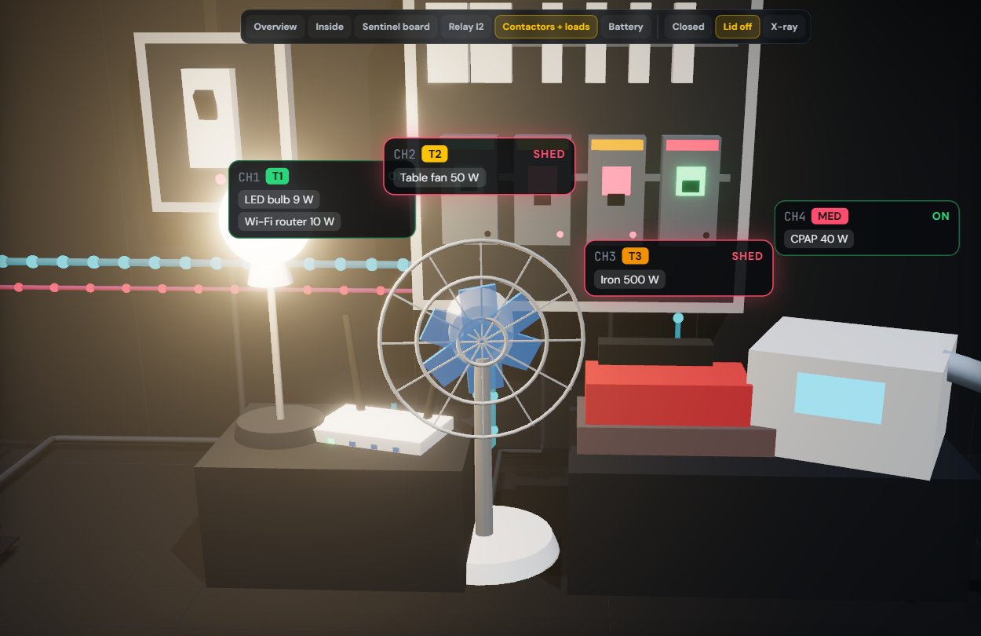
APPENDIX
Isolation
reinforced AMC1311 barrier; HV zone behind a moat; TVS on every line
Fail-safe
NC contactors — any fault, reset or brown-out brings loads back
Standards
IS 13252 / IEC 62368-1 (BIS gate) · IEC 62040 UPS · IEC 61000 EMC · IEEE 1159 / IEC 61000-4-30 Class-S-like PQ · UL94 V-0 enclosure
Charging
−24 mV/°C compensation, derate above 45 °C, stop at 58 °C, 2 s heartbeat revert to factory
V-Guard Sentinel · Big Idea Tech 2026, Track 4 · Team Codey Tingle (TI3271)
17
Notes:
If asked about safety certification: we target IS 13252 / IEC 62368-1 as the BIS gate; PQ is 'Class-S-like', never claimed Class A.

Slide 18
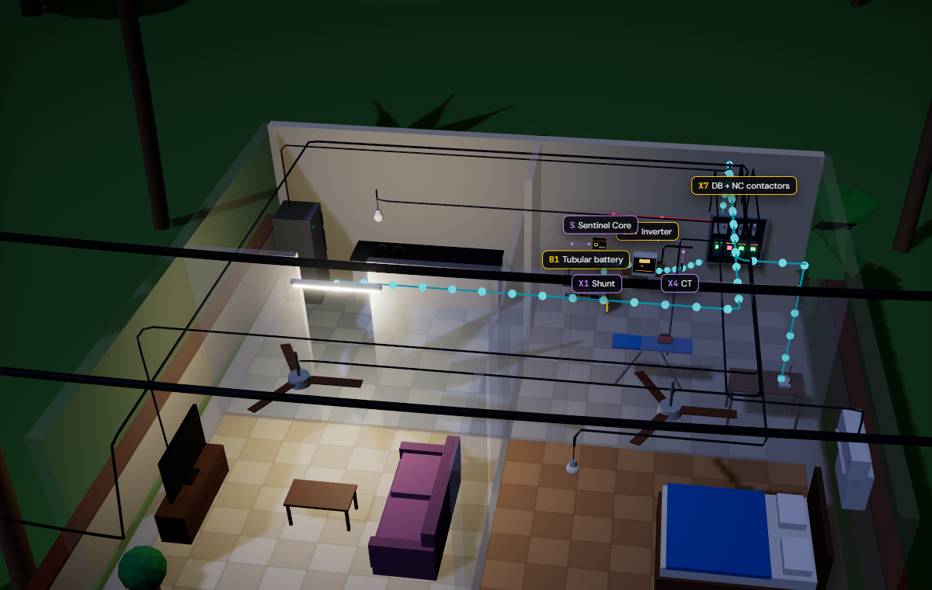
Coil off means loads on.
A window, never a date.
Offline first, fleet second.
Thank you — we'd love your questions.
Team Codey Tingle (TI3271)
Notes:
[9:45–10:00] Three lines to remember. Coil off means loads on — it fails safe. A window, never a date — it's honest about uncertainty. Offline first, fleet second — it works in the village before it ever talks to the cloud. Thank you — we'd love your questions. (Appendix slides follow for Q&A.)

